Slide 1
P.I.M Progression/Design Seminar
Created by: Personal information management department

Slide 2
What we will be talking about.
Our progress phase 1
Our goals in phase 2
Login/home screen
Policy accept/close pop up window
Login functionality
update existing personal information
Delete users
Feedback
Result
Questions?

Slide 3
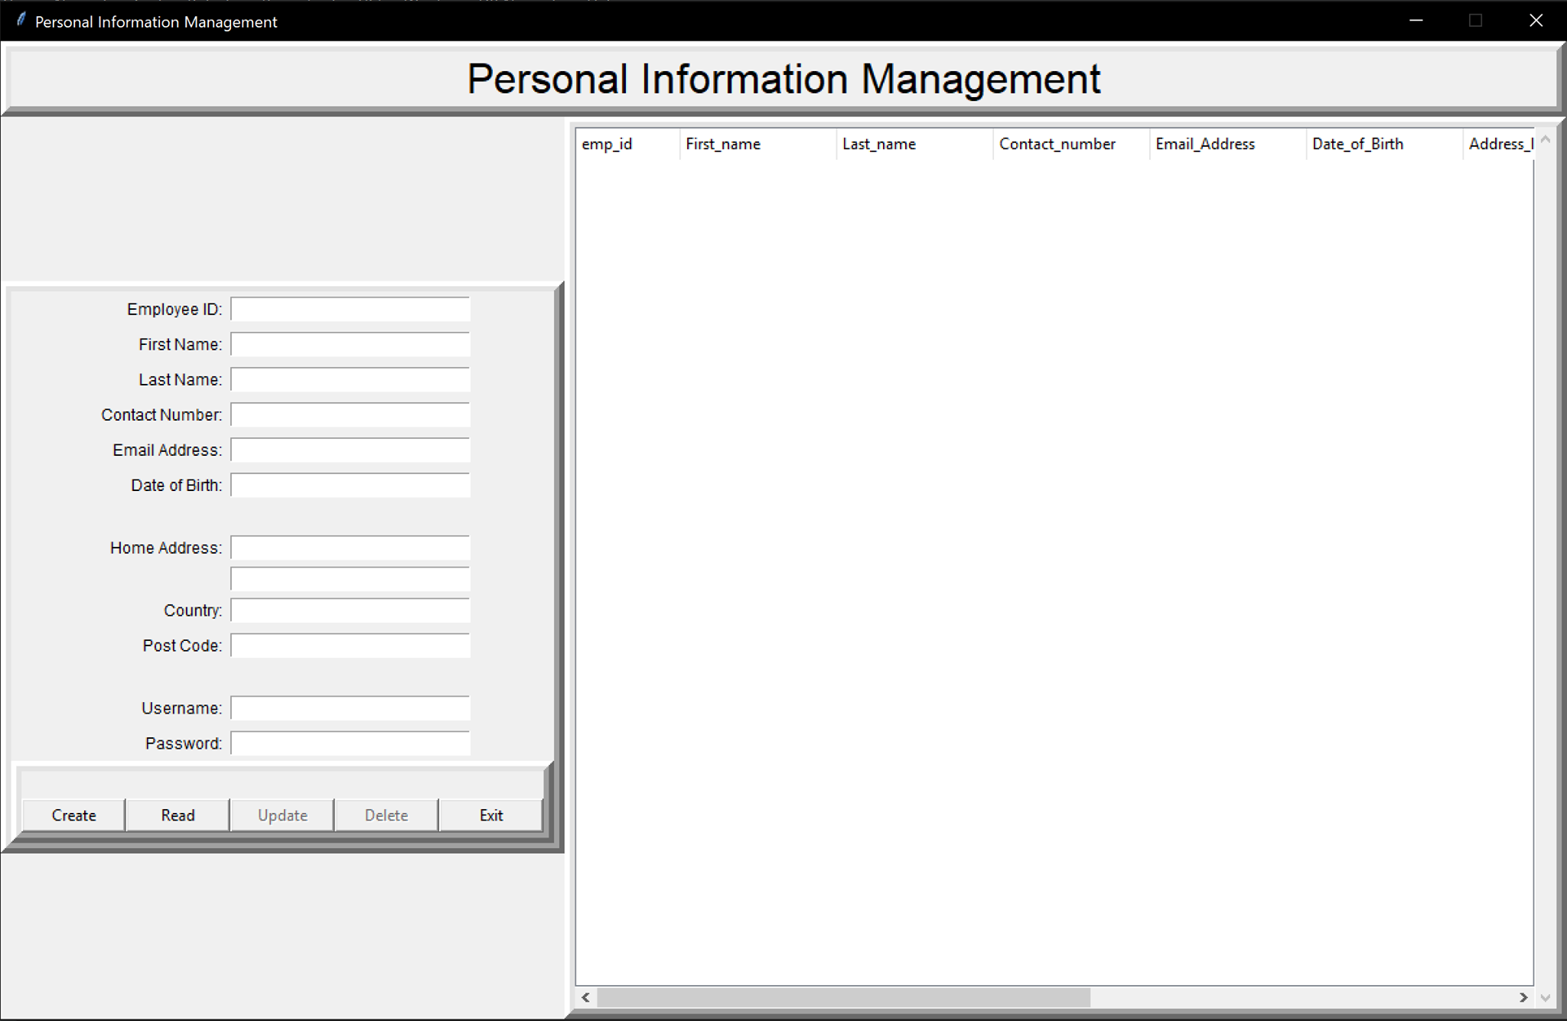
Progress phase 1

Slide 4
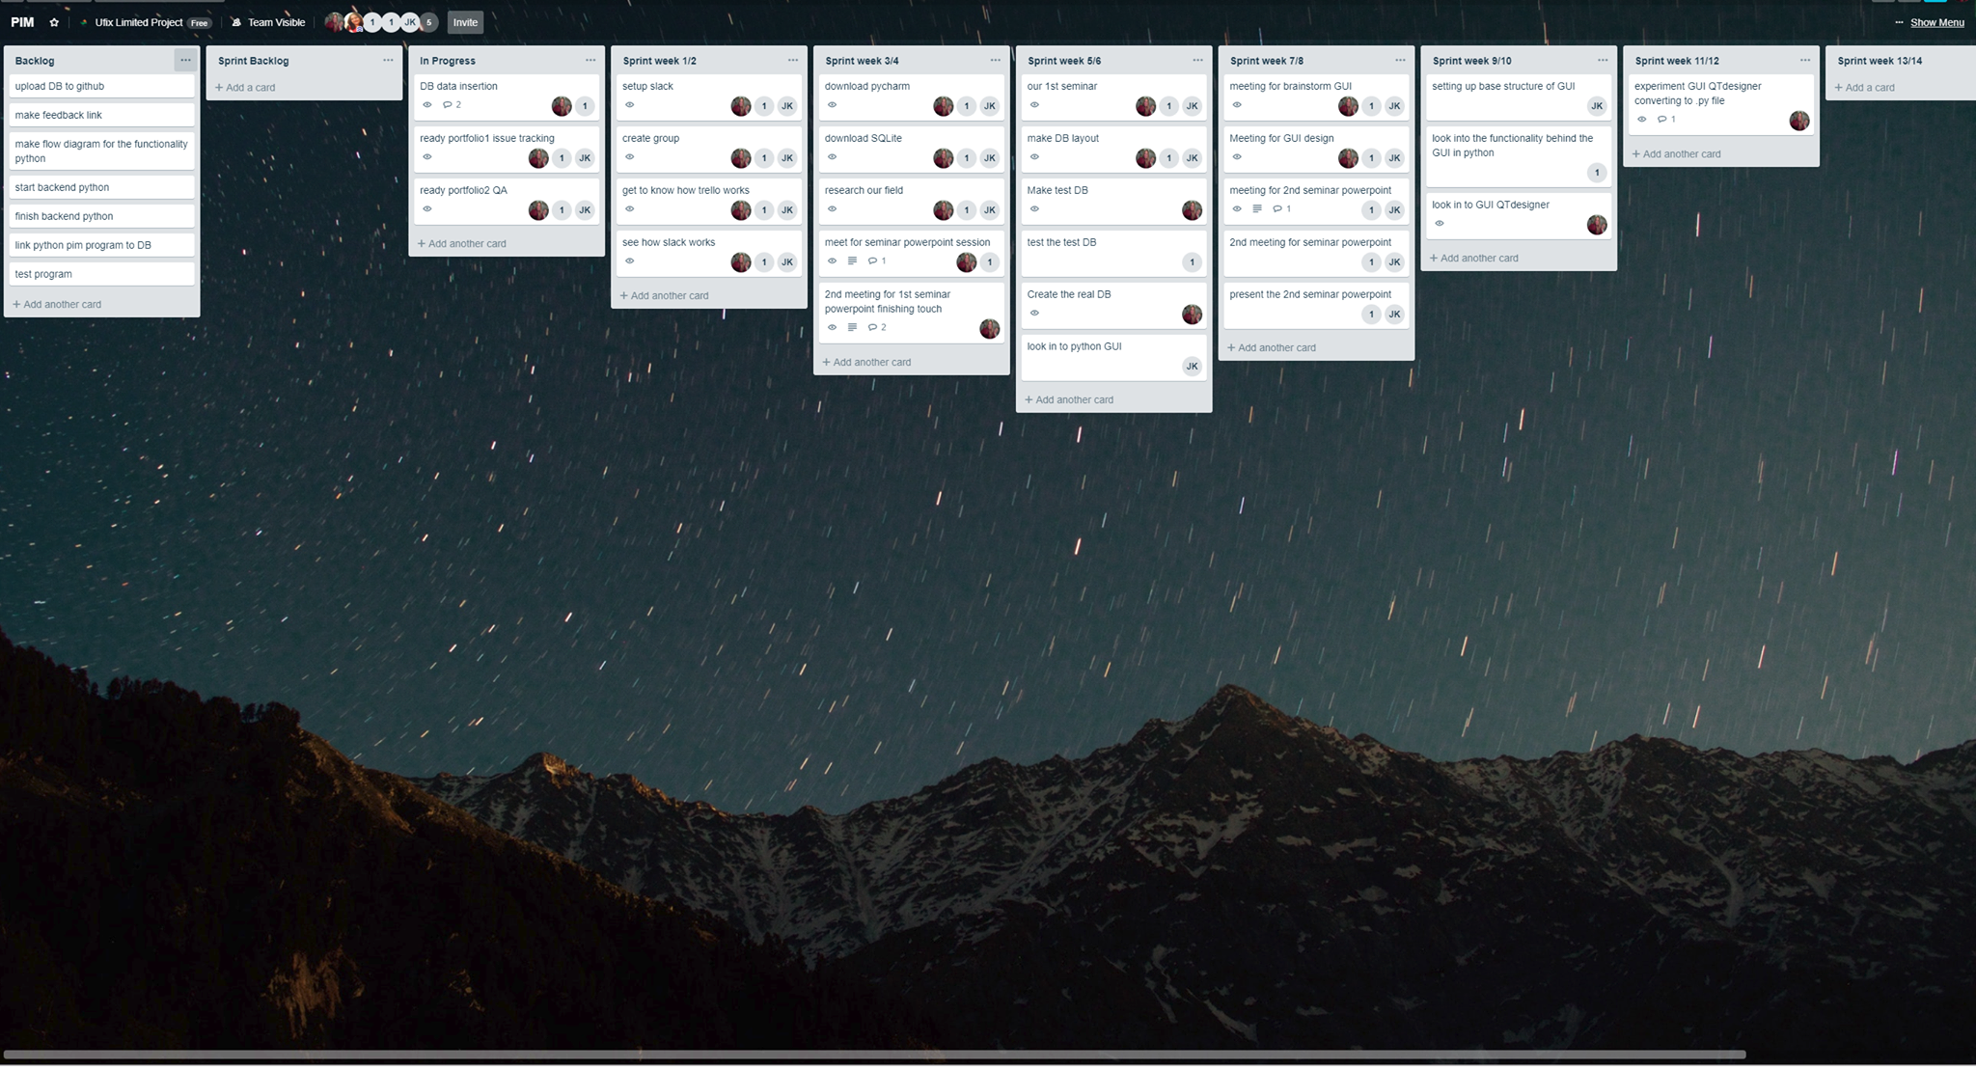

Slide 5
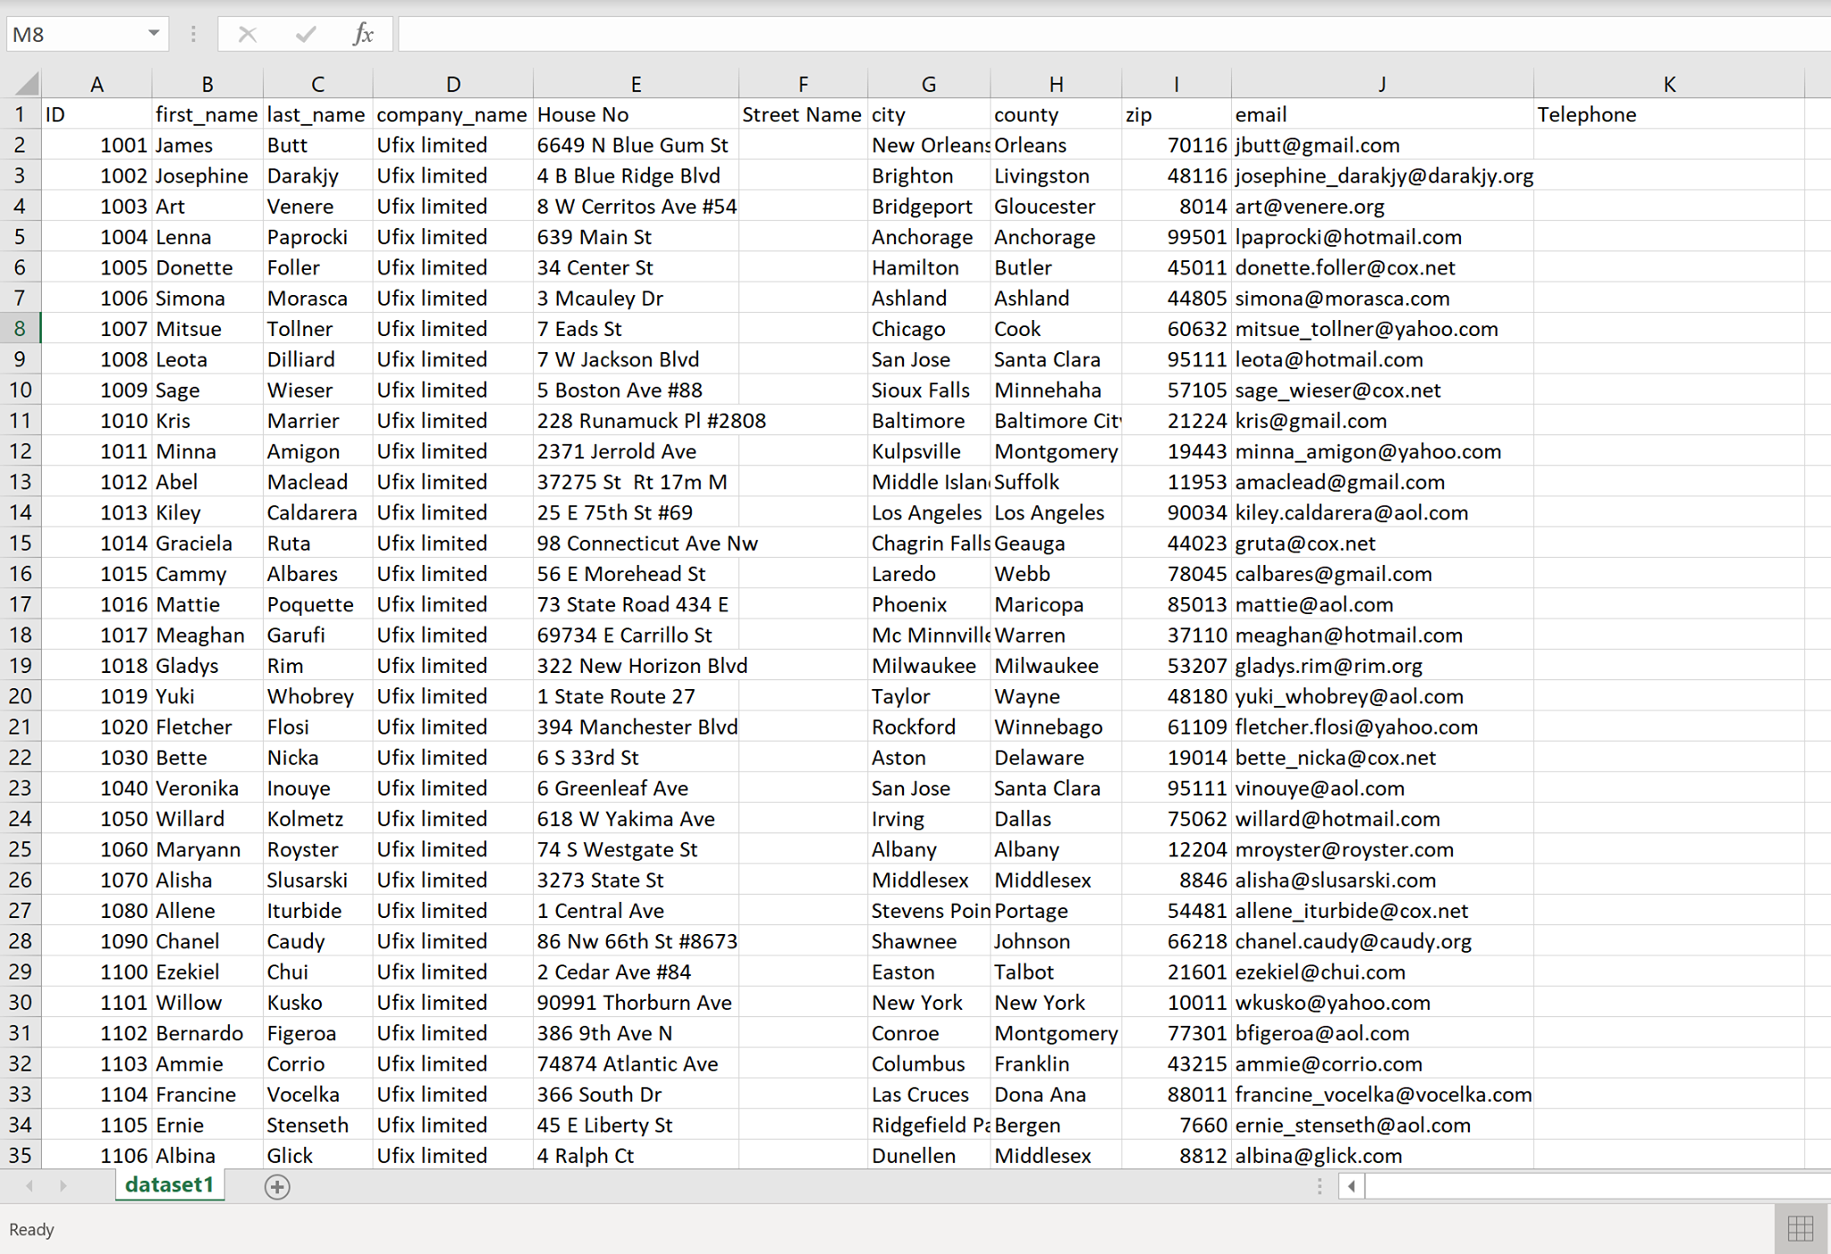

Slide 6
Our goals in phase 2
Functioning delete button
Functioning update button
Home screen
Login
Policy pop-up window

Slide 7

Functioning delete button

Slide 8
Functioning update button

Slide 9
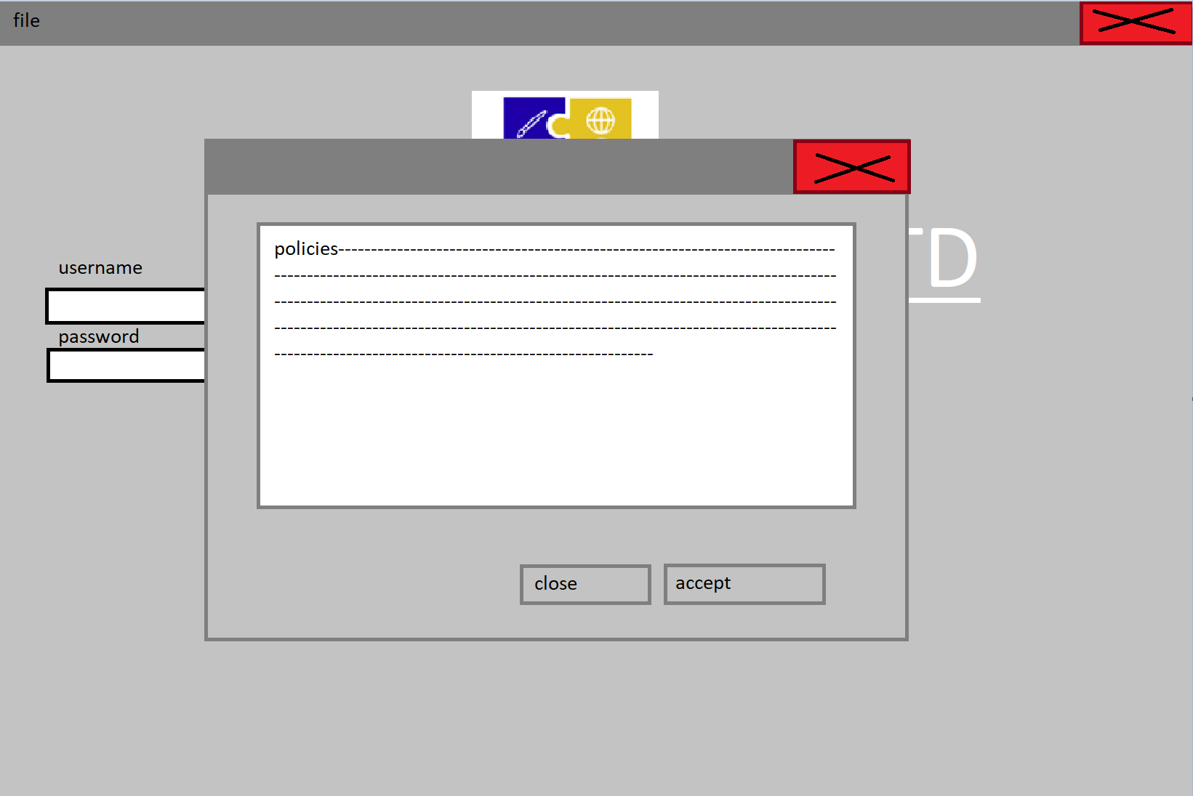
Policy pop-up window

Slide 10
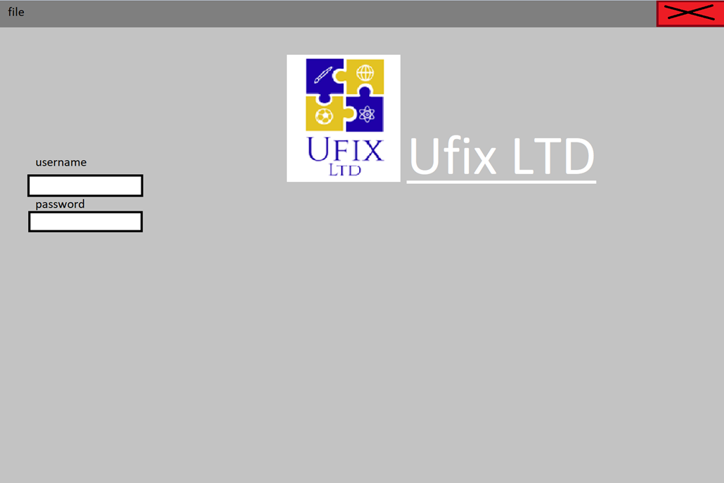
login

Slide 12
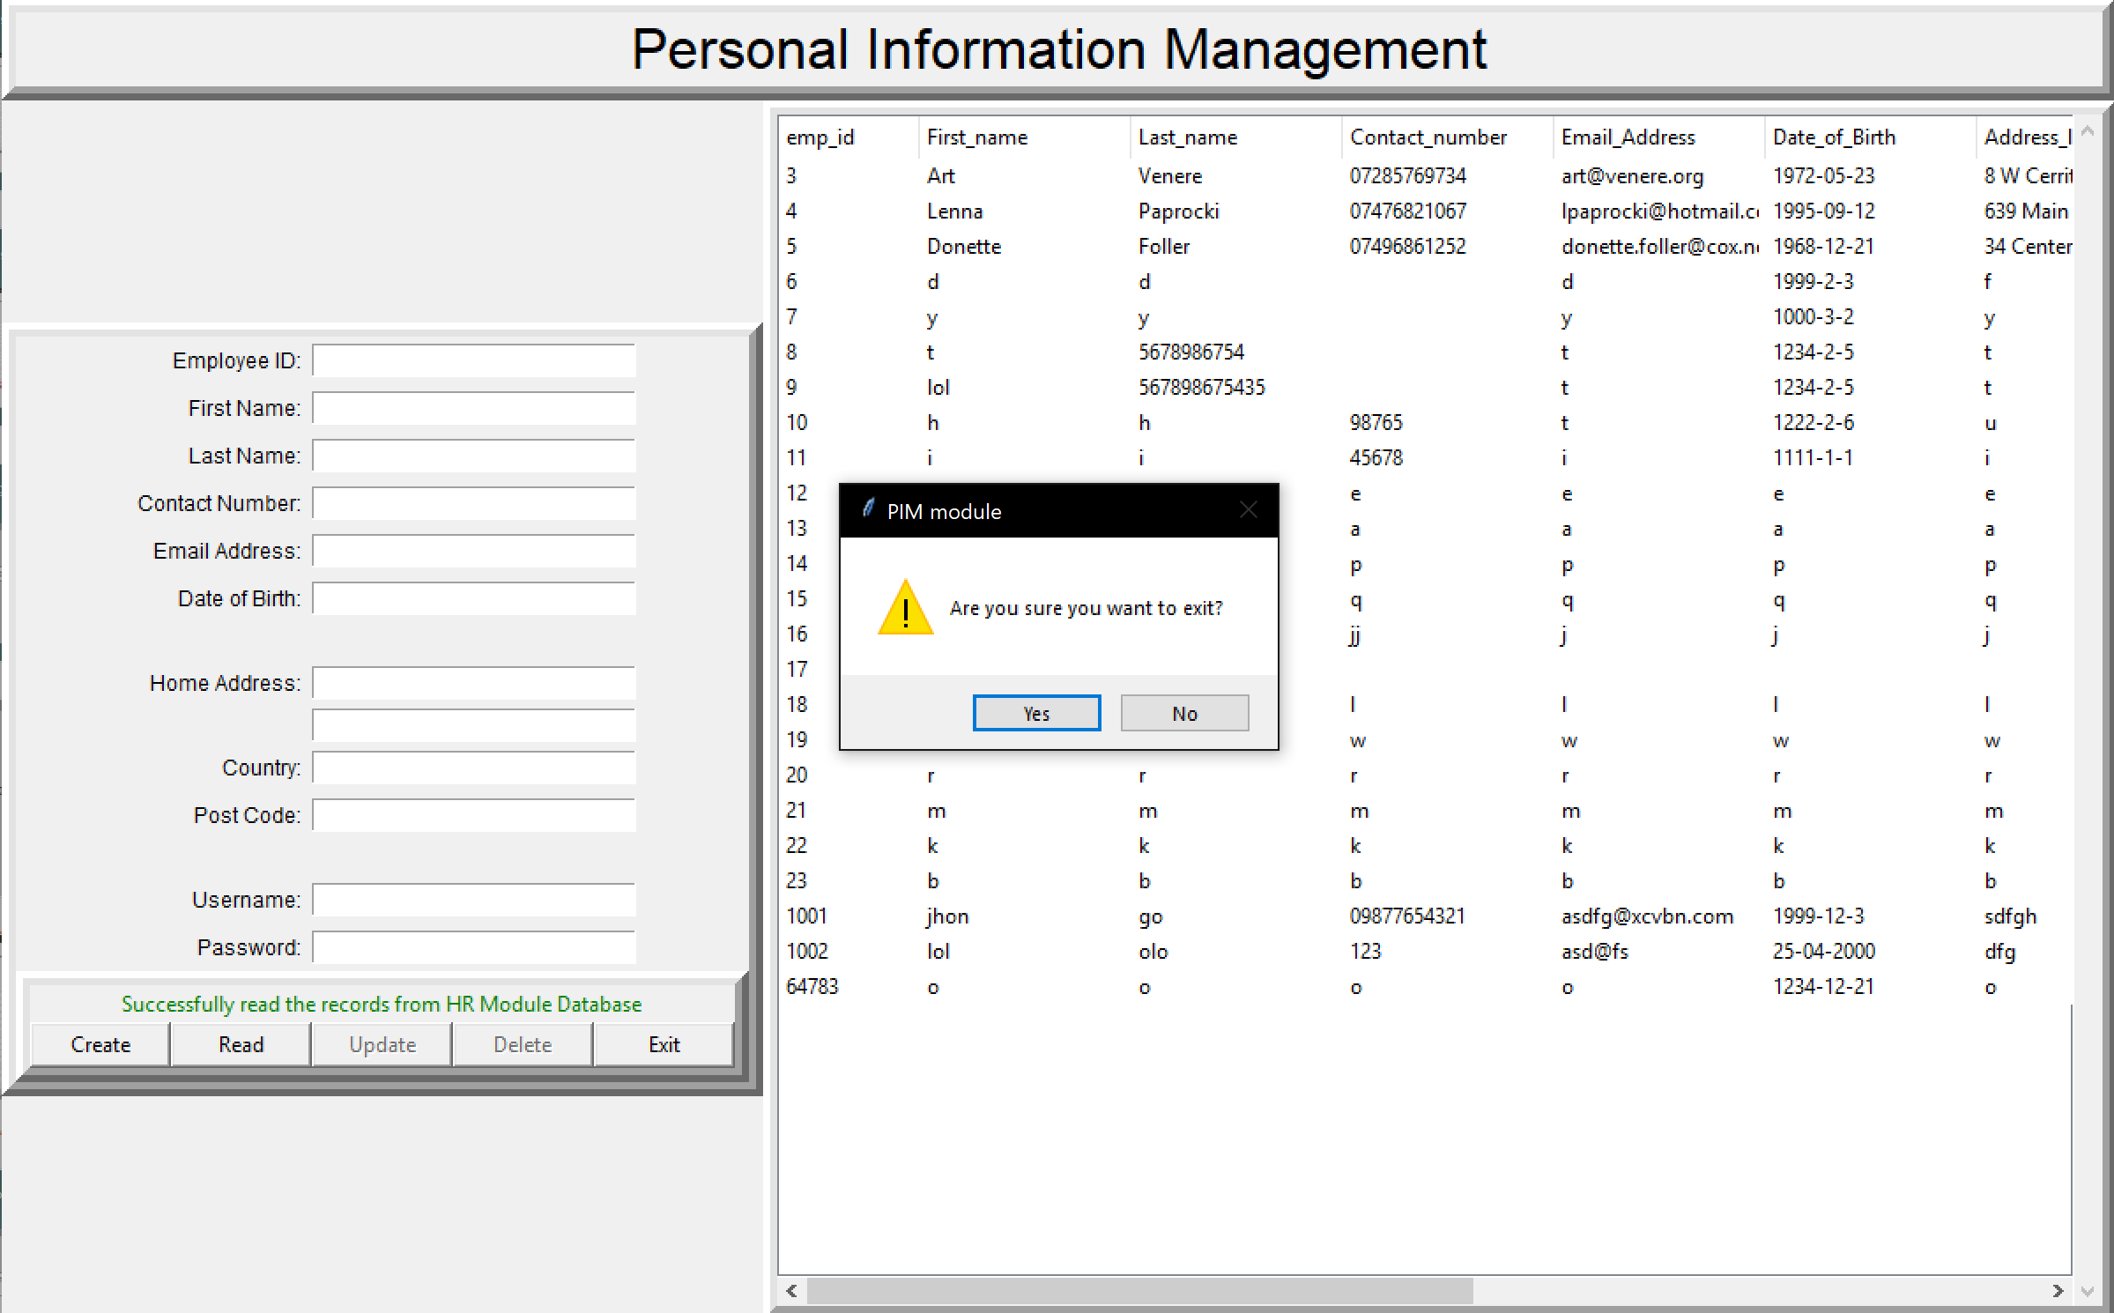

Slide 14
feedback
https://form.responster.com/MGuF1O

